Slide 1

Sharding Simulations
- By Om Amit Gandhi

Slide 2
Contents
Different Sharding Techniques (Previous Work)
Our Approach - Introduction
Our Approach - Design
Results of Simulation - MEMO Blockchain
Future Work
What is blockchain Sharding
Our Approach - Tool Validation
Non-sharded Comparison
Motivation
Our Approach - MEMO Architecture

Slide 3
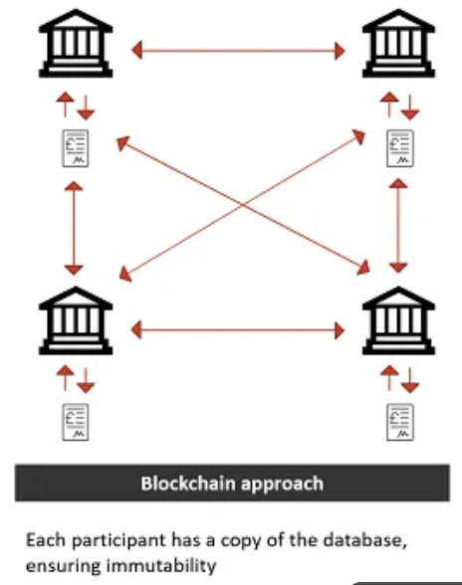
Motivation
Current single-chain designs cap throughput as demand surges.
We aim to scale TPS via sharding without increasing user-visible latency.
Security must remain constant (no weaker committees/assumptions).
Cross-shard messaging overhead may erase scaling gains as shards grow.
Problem: determine the shard count that maximizes TPS under fixed latency and security budgets.

Slide 4
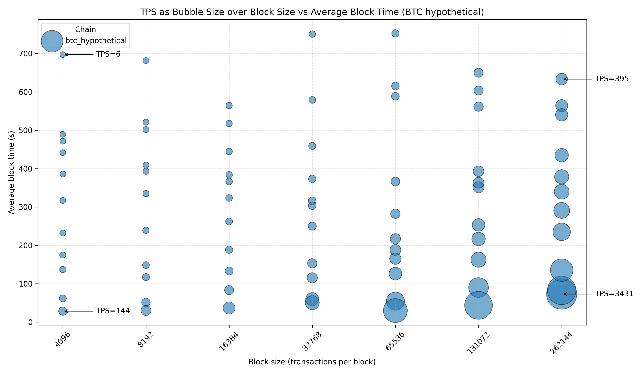
Motivation
Even if we increase the block size or decrease the block time, still the TPS can be scaled to 3500 in bitcoin.

Slide 5

What is Blockchain Sharding?
The general definition of sharding is the partitioning of the network into subsets known as shards, which allows them to validate transactions in parallel, resulting in performance and scalability improvements of the existing network.
Sharding in blockchain comes from the adaptation of traditional sharding in databases which involves partitioning the database into shards while blockchain sharding divides the network into shards or also called as committees that manages its own blockchain and has its own consensus protocol known as the intra-shard consensus along with the cross-shard consensus.
Sharding allows transactions in the network to be processed in parallel so that the throughput of the network increases.
The number of shards can then be increased accordingly to increase the throughput performance of the blockchain network.

Slide 6
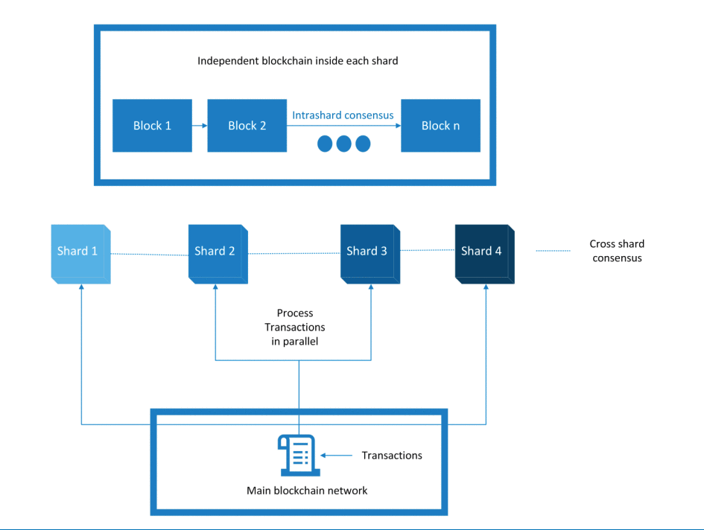
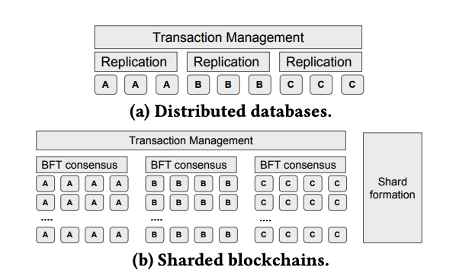
What is Blockchain Sharding?
Conventional Sharding

Slide 7

Different Sharding Techniques (Previous Work)
Transactions in the sharded network usually are of two types: Intra-shard, referring to the transactions between the nodes in that shard and cross-shard, referring to transactions between nodes located in different shards.
Based on this there were several techniques that addressed the communication.
One of those techniques is Pyramid sharding technique.
Here there are two types of shards, one is called i-shard and one is called b-shard.
i-shards are the ones that are responsible for only the internal transactions and b-shards are the ones that bridges multiple i-shards by dealing with cross-shard transaction related to the i-shard.

Slide 8
Different Sharding Techniques (Previous Work)
One of the other techniques is called monoxide:
Each zone runs its own simple blockchain in parallel.
They normally do not wait for each other, so a lot of work is done all at once.
Their mining scheme called as “Chu-ko-nu mining” scheme spreads mining effort and hence attacking one zone is as hard as attacking the entire system.
If A (in Zone X) pays B (in Zone Y), Zone X records the withdraw, then a relay is forwarded to Zone Y to finish the deposit. This is called eventual atomicity: once the withdraw is confirmed, the deposit will eventually be confirmed—without heavy 2-phase commit.
Because zones make progress independently, overall throughput rises roughly with the number of zones (minus the cost of coordinating cross-zone transfers). The paper’s testbed reported large throughput gains versus Bitcoin/Ethereum

Slide 9
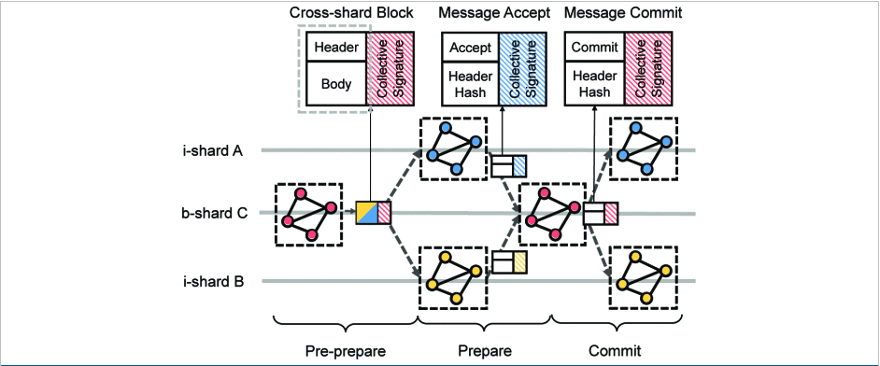
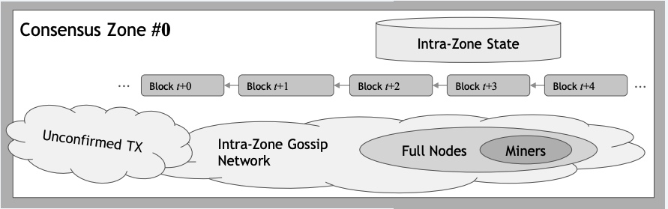
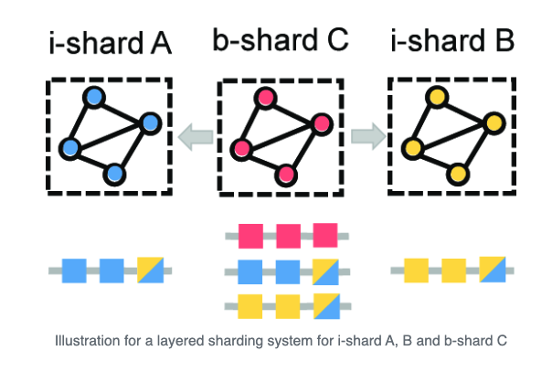
Different Sharding Techniques (Previous Work)
Pyramid Sharding
Monoxide Sharding

Slide 10
Our Approach - Introduction
Single-leader block assembly bottlenecks throughput and raises latency.
Our approach lets multiple miners to win per round and then contribute towards building a block in parallel.
Each winner assembles a shard, where shard headers are coordinated and ordered deterministically to form a block.
This would help us benchmark and determine that at how many shards do we get the best throughput while maintaining a stable latency over the network.

Slide 11
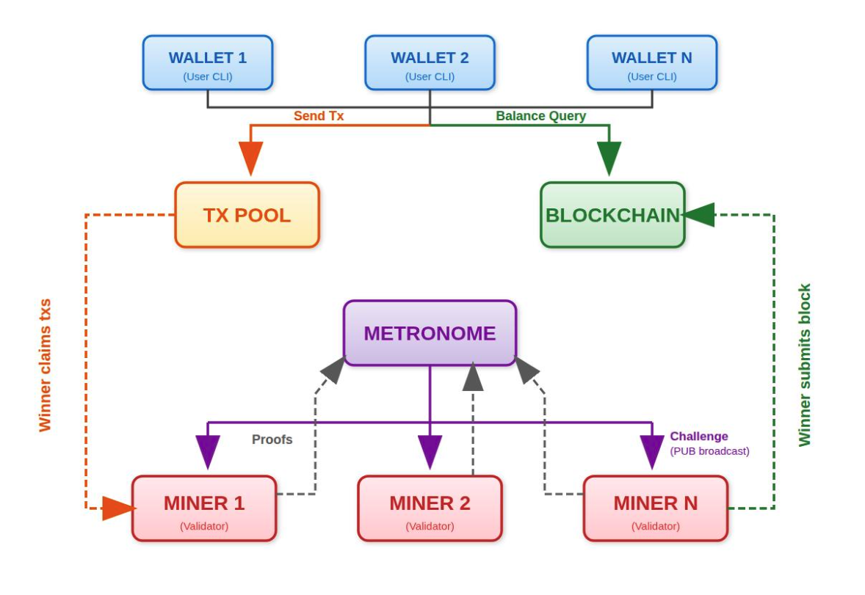
Our Approach – MEMO Architecture

Slide 12
Our Approach - Design
Many participants run the consensus mechanism.
Let’s say after that we have multiple winners for that round based on the difficulty and mechanism, each winner will be counted as a single shard in that case.
Each shard or the winner would have their own disjoint subset of state and transactions.
Winners would execute the transactions for their shard and produce the shard output.
The shard then communicates among themselves or the metronome node to form the block.
The metronome would also verify the transactions and the entire block itself and then the block will be published to the blockchain and then it will be broadcasted to all the miners, and the process begins again.

Slide 13
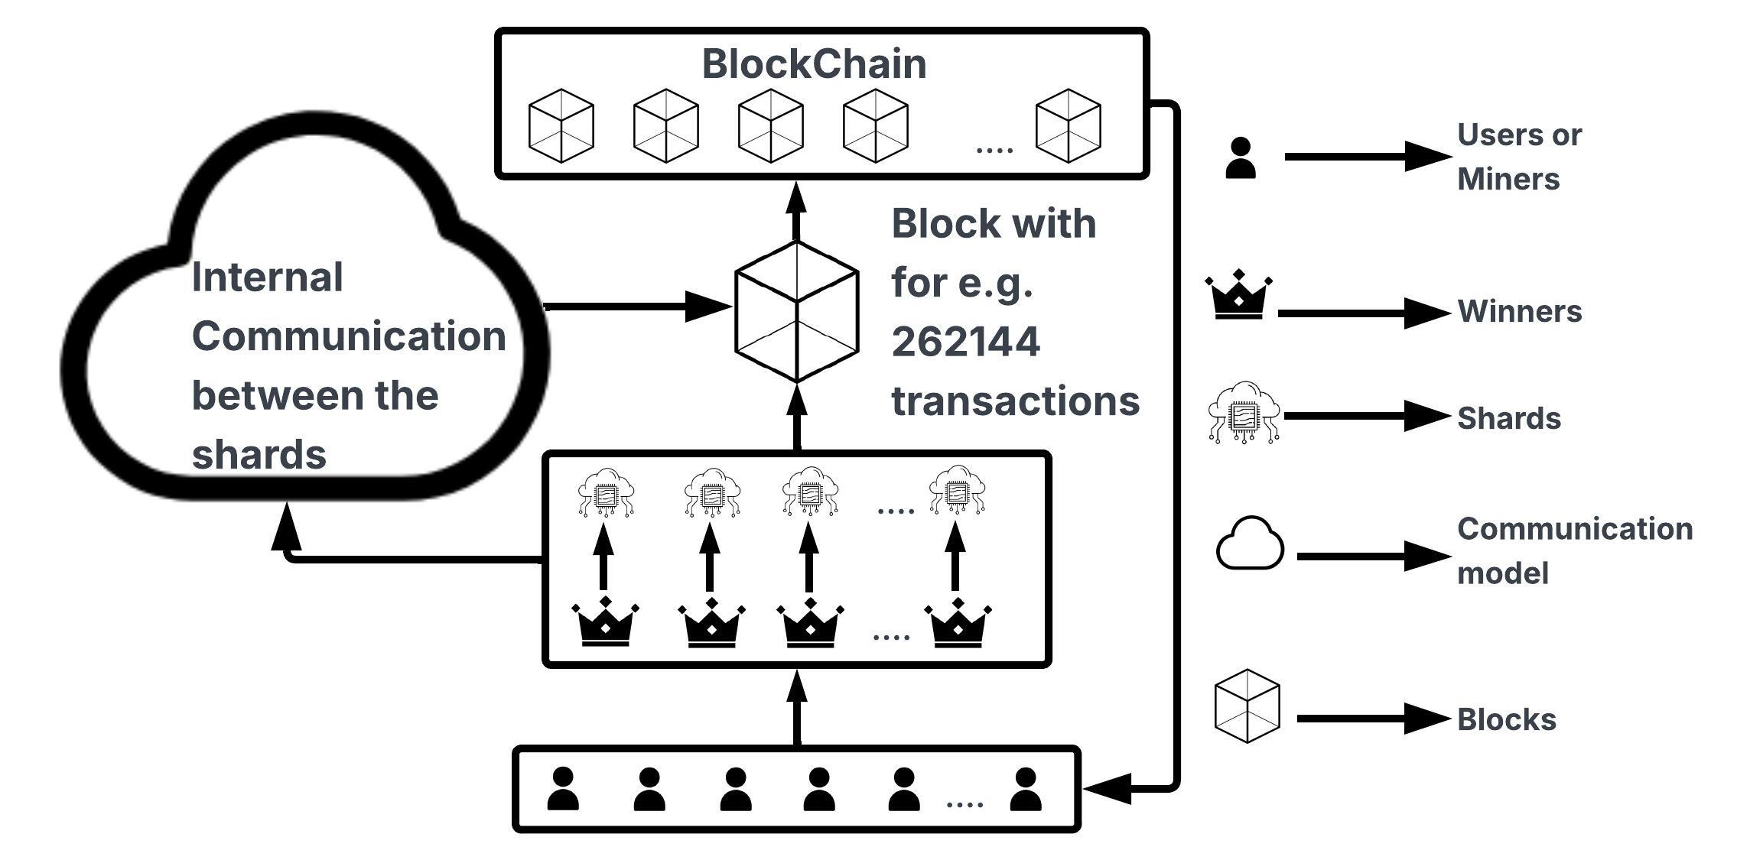
Our Approach – Design

Slide 14
Our Approach – Network Communication
Shards or the winners firstly communicate among themselves to form the block.
In another approach, the leader metronome communicates with these shards to form the block.
After that the metronome will publish the block to the blockchain and then will broadcast that to all the miners itself.

Slide 15
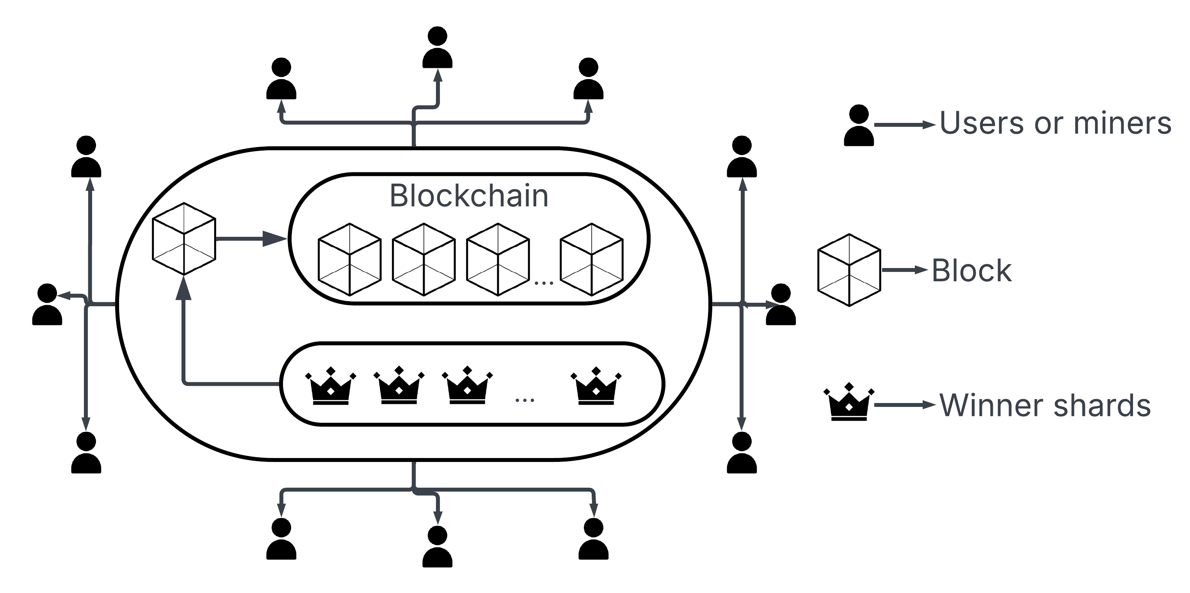
Our Approach – Network Communication (No Metronome)

Slide 16
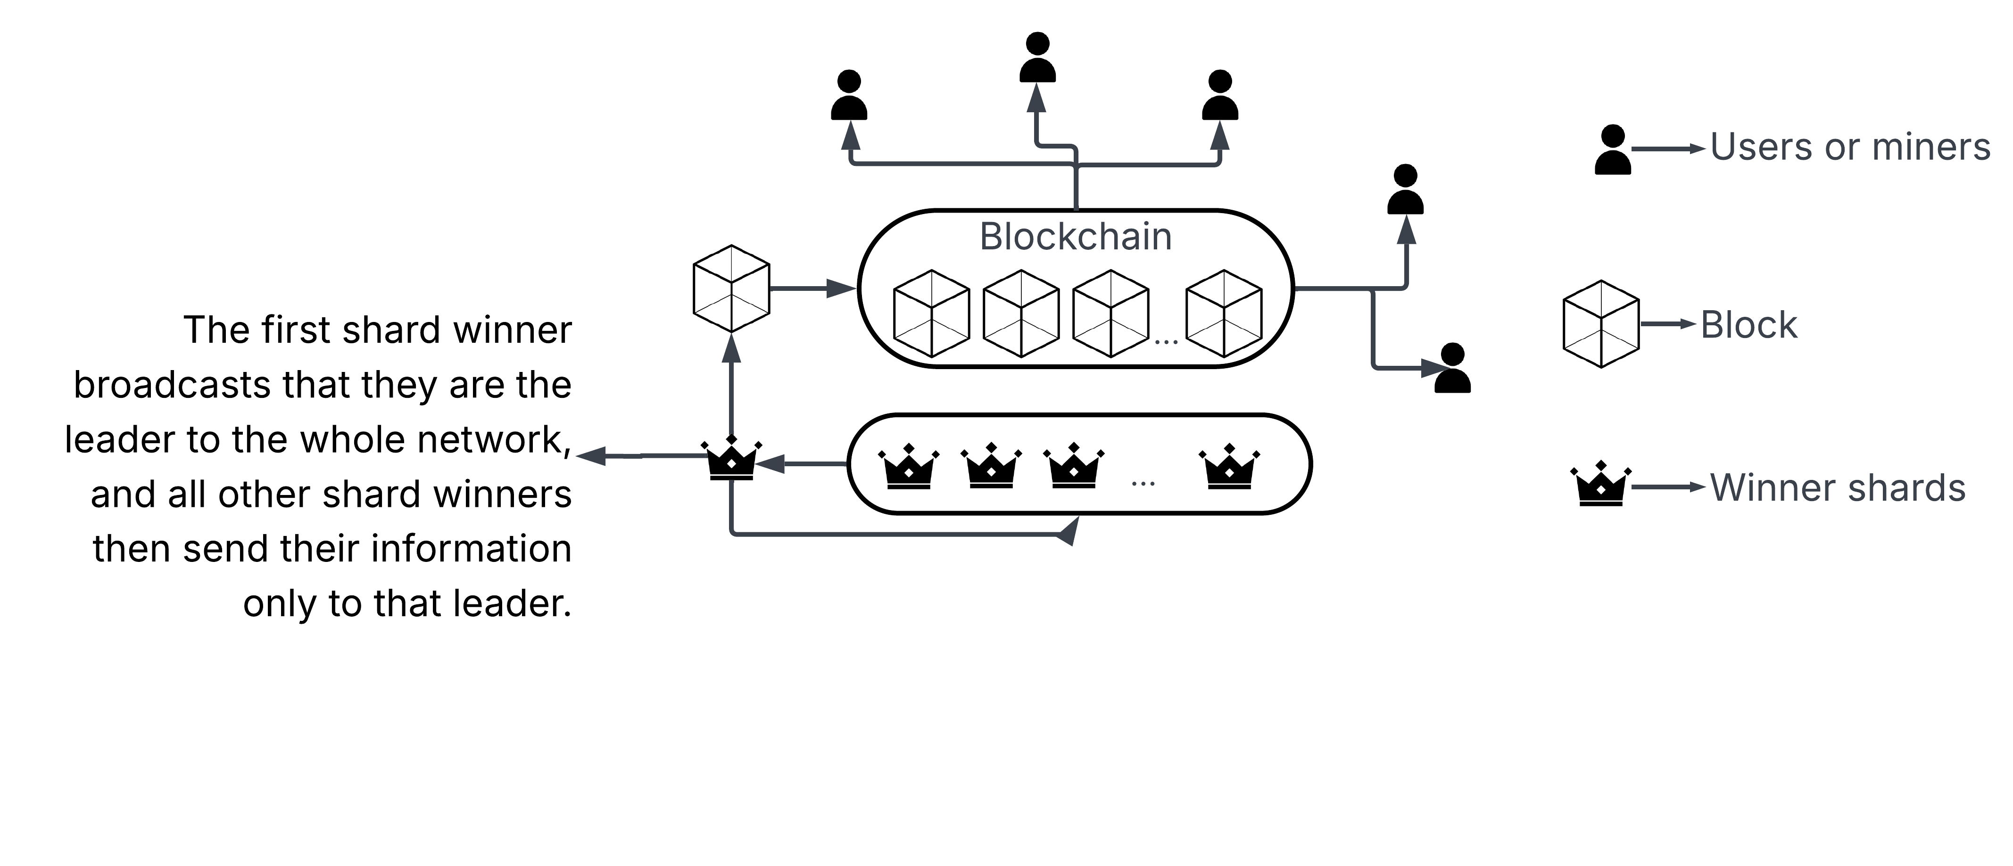
Our Approach – Network Communication (Leader Metronome)

Slide 17

Our Approach – Tool Validation
Here I have conducted various benchmarks trying to simulate the conventional chains and validate the simulator tool.
The benchmarks are done on the simulated and real-world values of Bitcoin, Bitcoin Cash, Litecoin, and Dogecoin
Here are the results that we can compare:
TPS vs chains
Block-time vs chains
Notes:
MOstly, think about validation, look into historical data

Slide 18
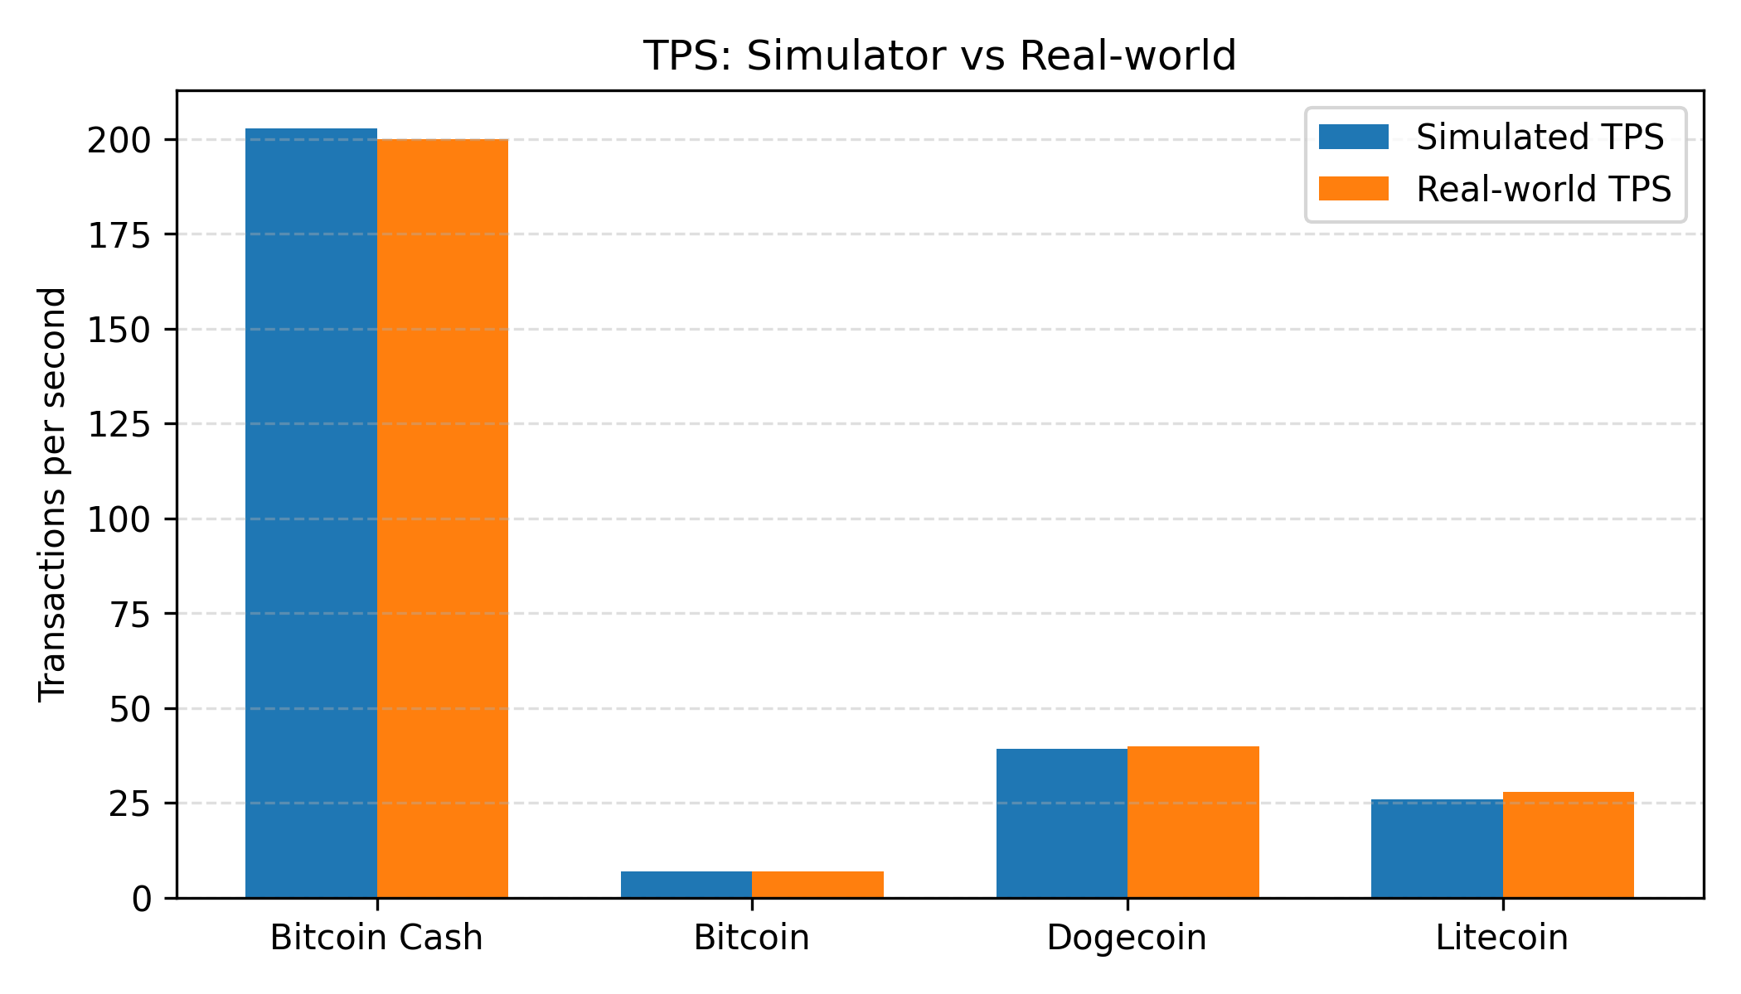
Our Approach – Tool Validation
TPS vs Chains
Our simulator reproduces realistic TPS levels and the correct relative ordering across BTC, BCH, LTC, and DOGE, confirming that throughput is plausibly calibrated.

Slide 19
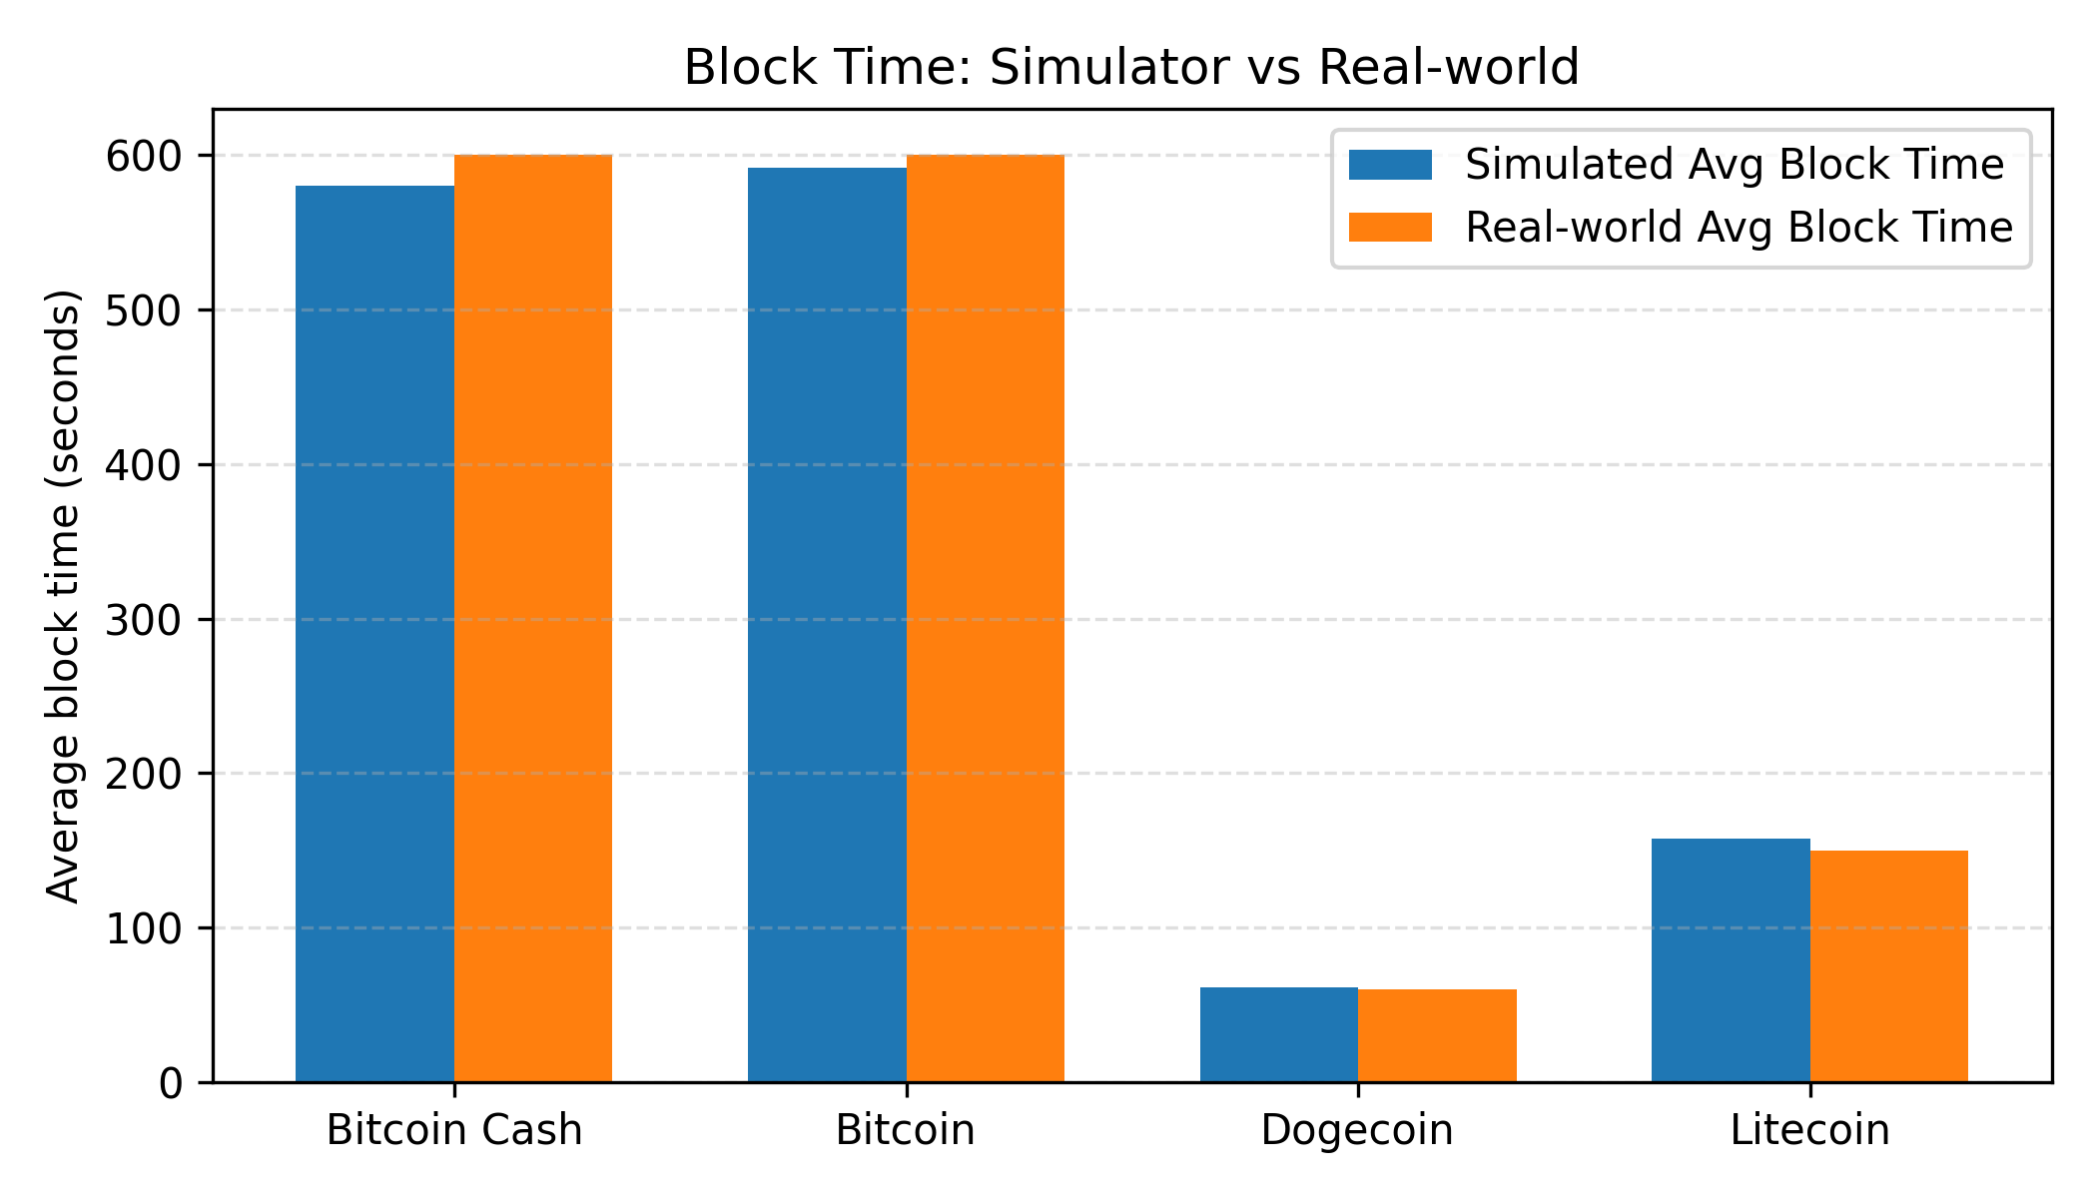
Our Approach – Tool Validation
Block-time vs Chains
Simulated average block times closely match each chain’s real target block interval, validating that our difficulty and timing model is realistic.

Slide 20
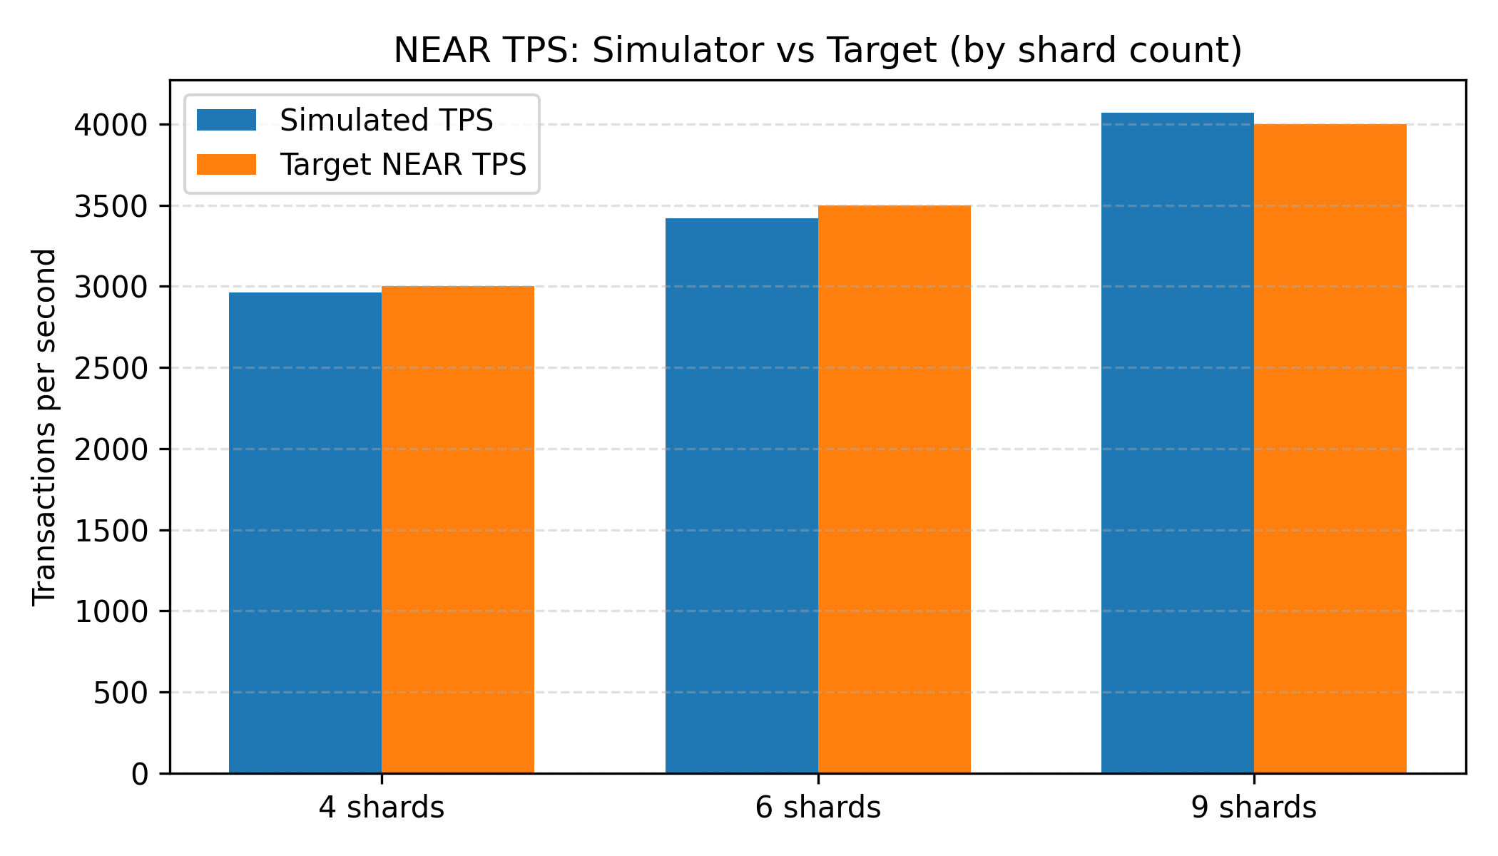
Our Approach – Tool Validation
TPS vs Chains
Our simulator reproduces realistic TPS levels and the correct relative ordering across 4, 6 and 9 shards of NEAR confirming that throughput is plausibly calibrated.

Slide 21
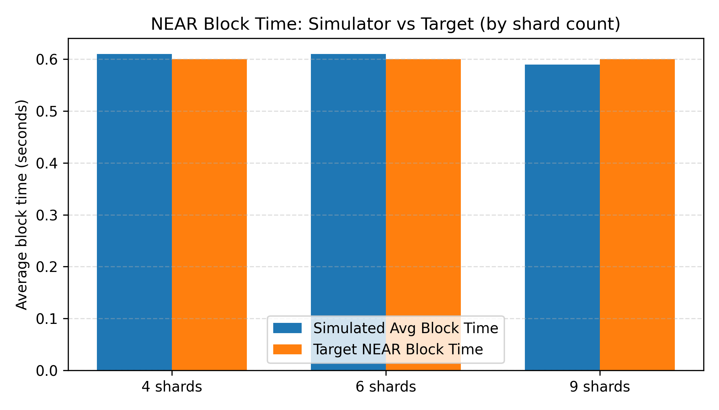
Our Approach – Tool Validation
Block-time vs Chains
Simulated average block times nearly matches the block-time claimed by NEAR and so maybe we can conclude that for validation we might need tweaks in the block-size to match that of NEAR.

Slide 22
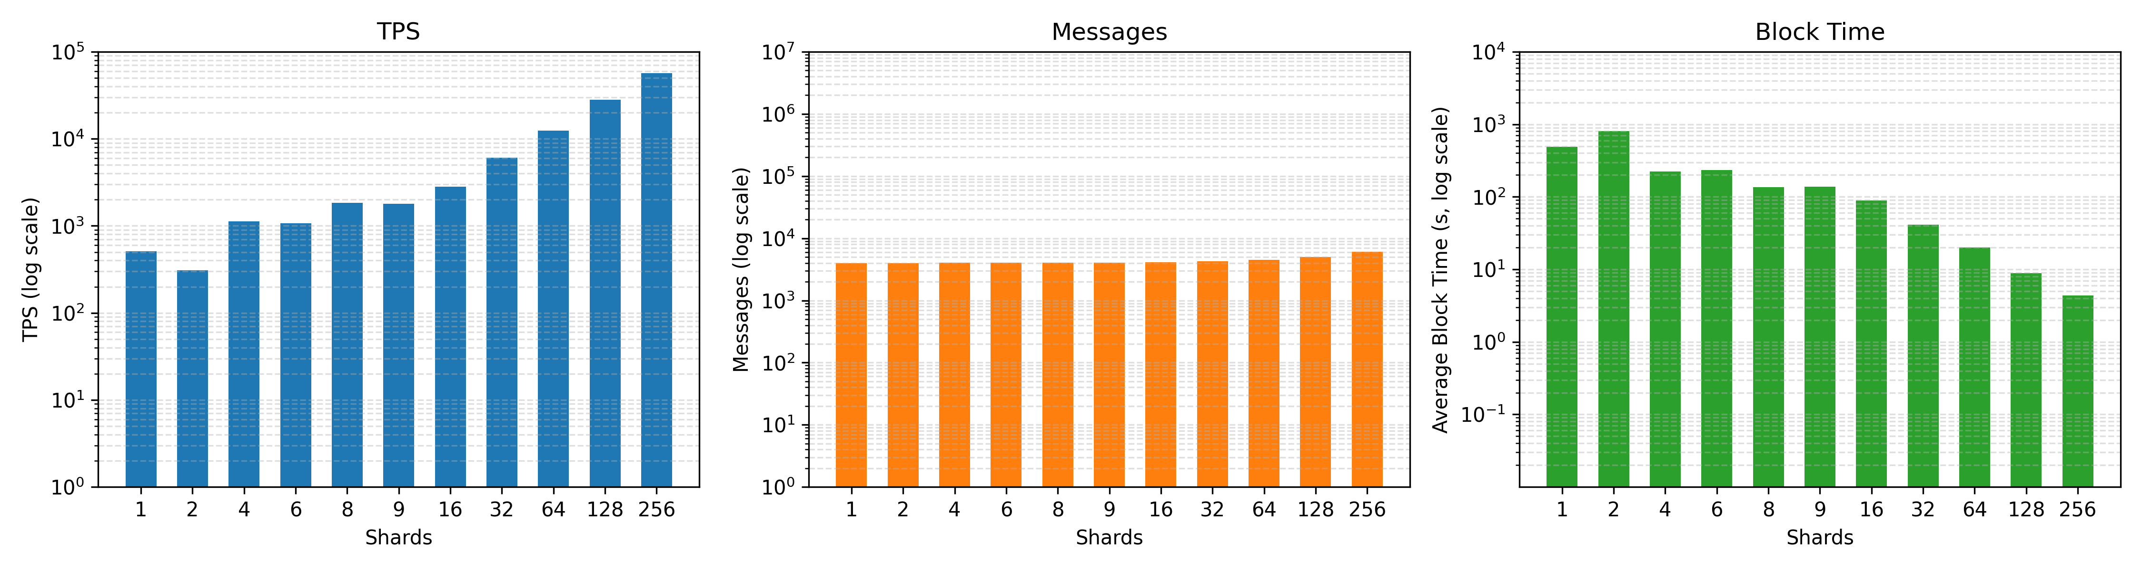
Results of Simulation – Intra Region
Best TPS
Here we have results for the best TPS for the intra-region memo sharding for a block size of 262,144 transactions.

Slide 23
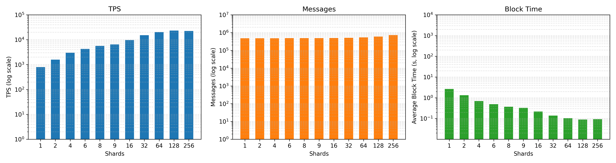
Results of Simulation – Intra Region
Best Finality
Here we have results for the best finality for the intra-region memo sharding for block size of 2,100 transactions.

Slide 24
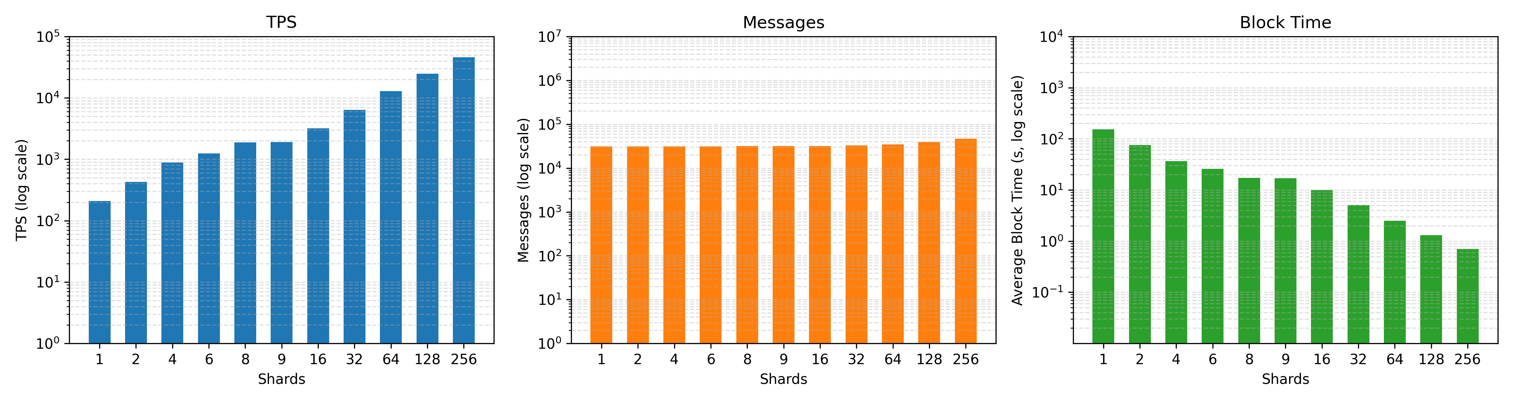
Results of Simulation – Intra Region
Sweet Spot
Here we have results for our sweet spot for the intra-region memo sharding for block size of 32,768 transactions.

Slide 25
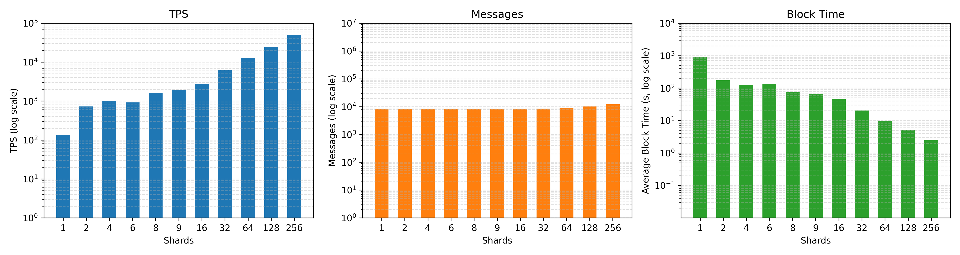
Results of Simulation – US WAN Baseline
Best TPS
Here we have results for the best TPS for the US WAN baseline for memo sharding for block size of 131,072 transactions.

Slide 26
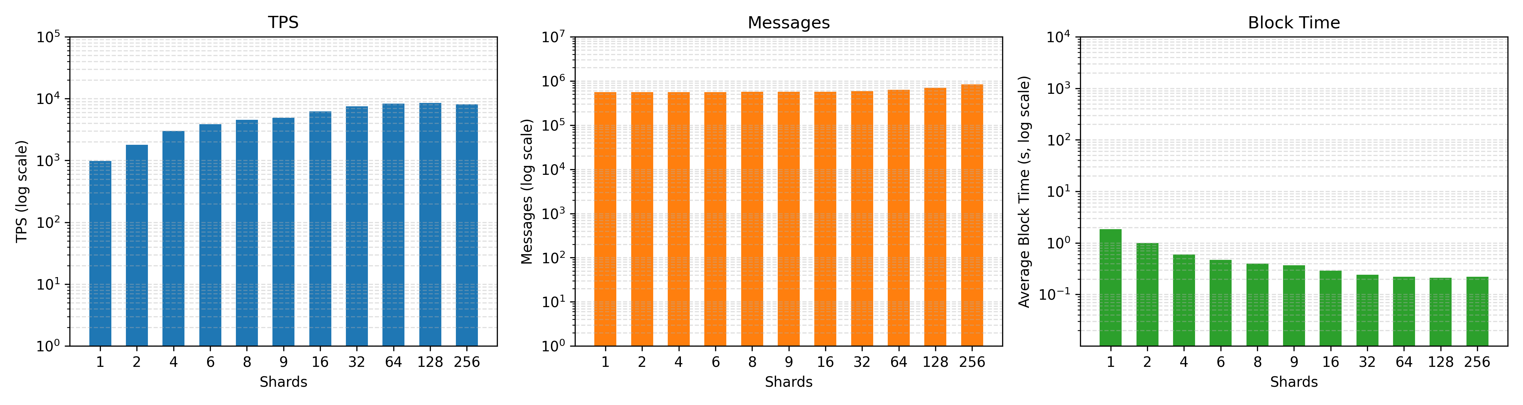
Results of Simulation – US WAN Baseline
Best Finality
Here we have results for the best Finality for the US WAN baseline for memo sharding for block size of 1,800 transactions.

Slide 27
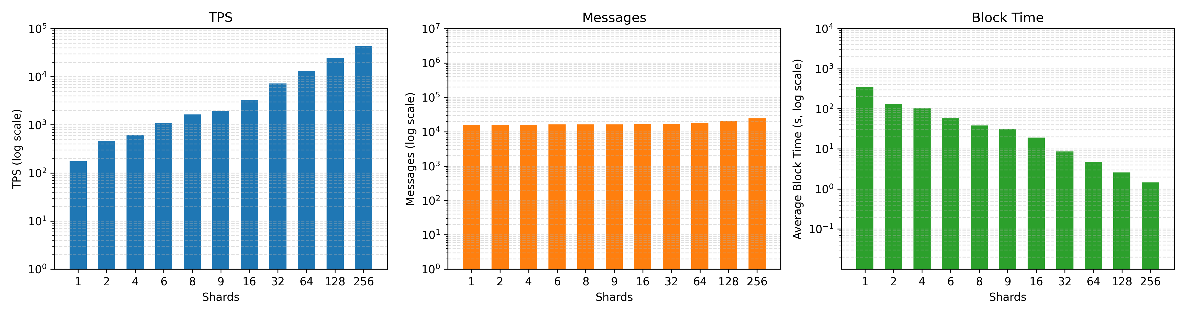
Results of Simulation – US WAN Baseline
Sweet Spot
Here we have results for the sweet spot for the US WAN baseline for memo sharding for block size of 65,536 transactions.

Slide 28
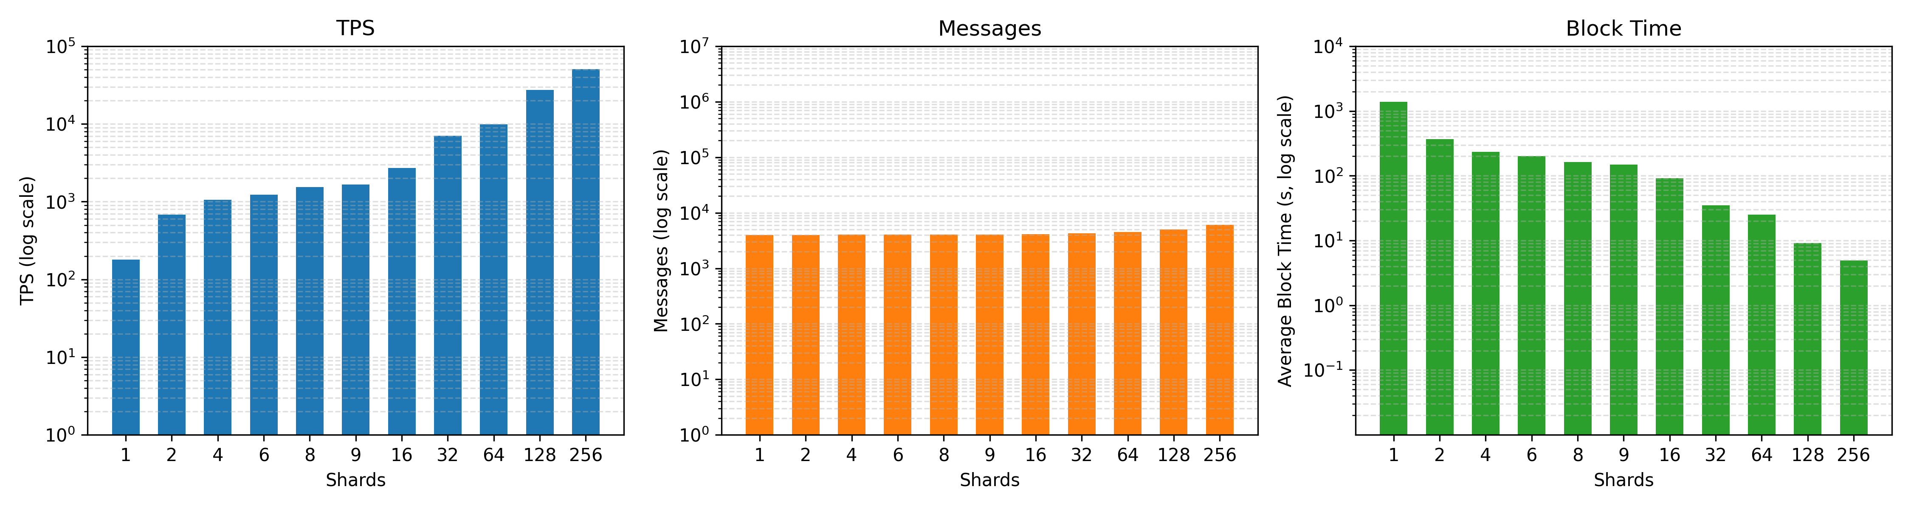
Results of Simulation – Global WAN
Best TPS
Here we have results for the best TPS for the global WAN region for memo sharding for a block size of 262,144 transactions.

Slide 29
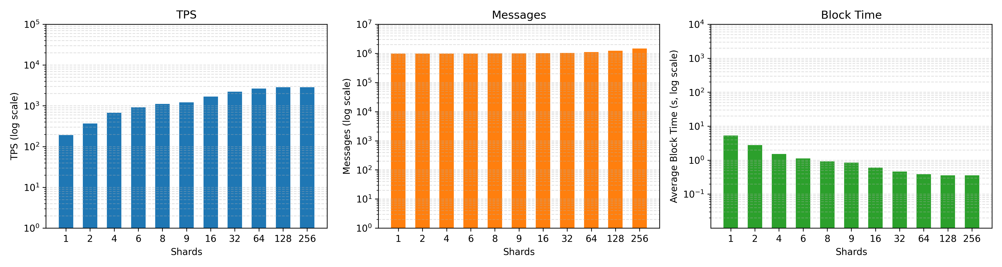
Results of Simulation – Global WAN
Best Finality
Here we have results for the best Finality for the global WAN region for memo sharding for a block size of 1,024 transactions.

Slide 30

Results of Simulation – Global WAN
Sweet spot
Here we have results for the sweet spot for the global WAN region for memo sharding for a block size of 65,536 transactions.

Slide 31
Future Work
Build a prototype to deploy a real system and see if the simulation results can be validated in real life.
Test on the chameleon test bed with 80 nodes to get real time metrics and results.
Perform test validations on the new claim of NEAR blockchain of 1 million transactions per second with half a second of block time in real system.

Slide 32
Questions?

